Slide 1
Play It
Forward
CS 400
Created By: Megan Cole and Kory Kipperda
Toy selling, trading, and donating application.

Slide 2

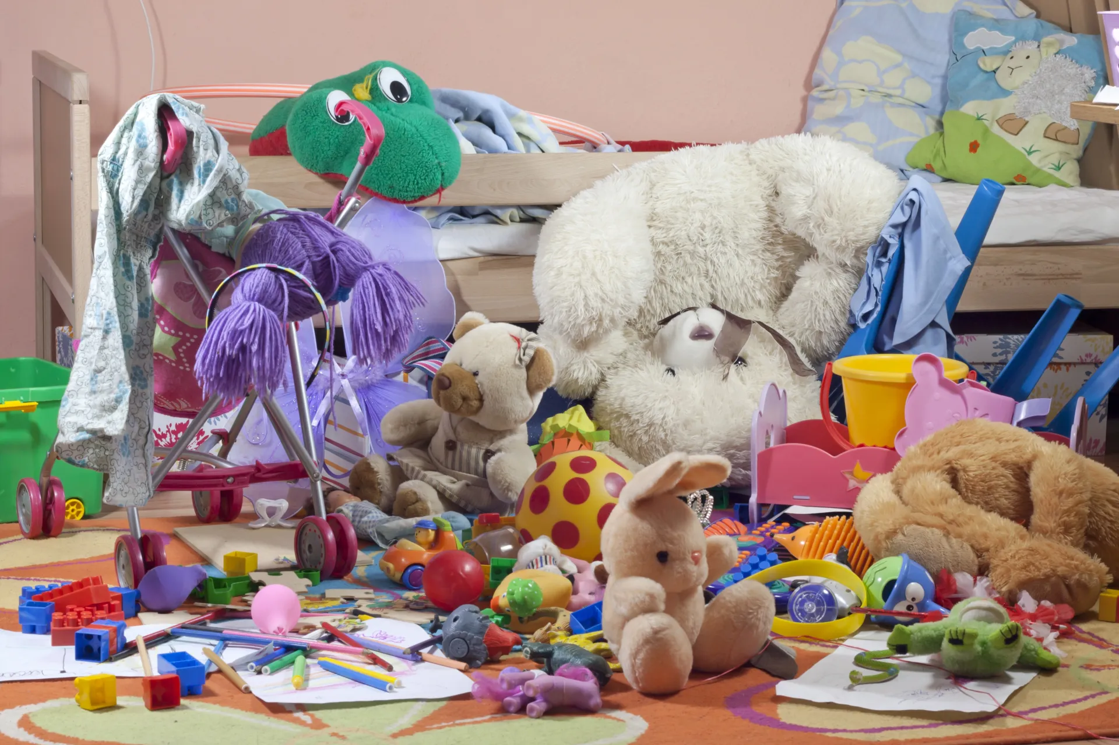
Sharing the Joy of Play, One Toy at a Time.

Slide 3

Our Vision
Play It Forward is designed for parents, caregivers, and individuals looking to pass on or acquire gently used toys. The platform caters to people seeking educational toys for younger children and focuses on connecting them with toys that support cognitive and physical development. Non-profit organizations can also benefit by receiving toy donations or distributing toys to families in need, creating a bridge between individuals and those who require toys for children in their care.

Slide 4
Why Us?
Localized Search
Age-Specific Toy Listings
Donation Focus
You can find toys to donate, trade, or buy locally, fostering connections and supporting nearby families and organizations.
You can browse toys tailored to your desidered age group to ensure that toys are more relevant to your child.
We focus on donations and trades over sells to ensure that our main focus is on organizations and families in need.

Slide 5
Who are our users?
Photo from: Kansas Children’s Discovery Center
You may be wondering why to use Play It Forward. Let us introduce you to some of our perspective users!

Slide 6
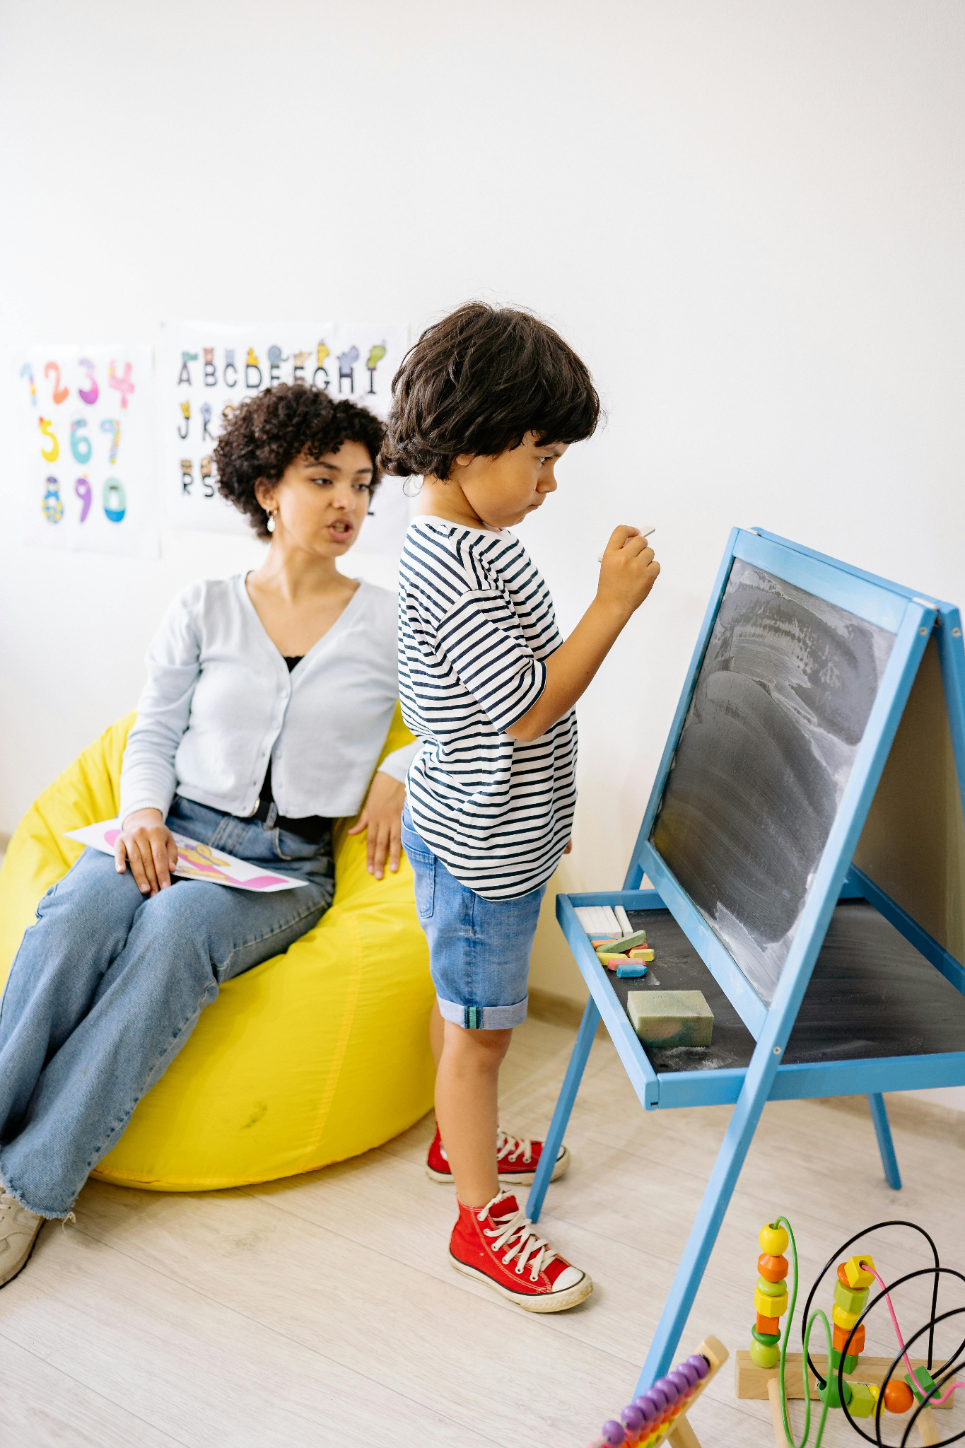
Meet Bronwyn
Bronwyn is a 39 year old, stay at home mom from South Africa who immigrated to the United States.
As a mom of 2, she is always looking for new learning activities and educational toys to help her children learn while playing. She also is seeking a way to donate toys her kids have outgrown that she cannot donate to the school.
Bronwyn is a member of the PTO at her children’s school. She is always looking for toys and learning material for after school activities without driving all over town.
Photo by Yan Krukau: https://www.pexels.com/photo/boy-standing-in-front-of-a-blackboard-beside-a-woman-seated-on-a-bean-bag-8613090/

Slide 7

Meet Shannon
Shannon is a 37 year old, mom of 3 from Missouri. Shannon works from home as a help desk manager. She is always looking for engaging toys on days that her children are home while she is working.
Shannon has used Facebook Marketplace to sell toys. However, she is frustrated to find that some people will buy items from her then sell them at a higher price.
Shannon has become interested in finding places to donate her toys instead to avoid this frustration. In addition, she is looking for reasonably priced toys that are educational and engaging for her own children.
Photo by Ketut Subiyanto: https://www.pexels.com/photo/happy-mother-working-from-home-and-little-daughter-hugging-mom-4474045/

Slide 8
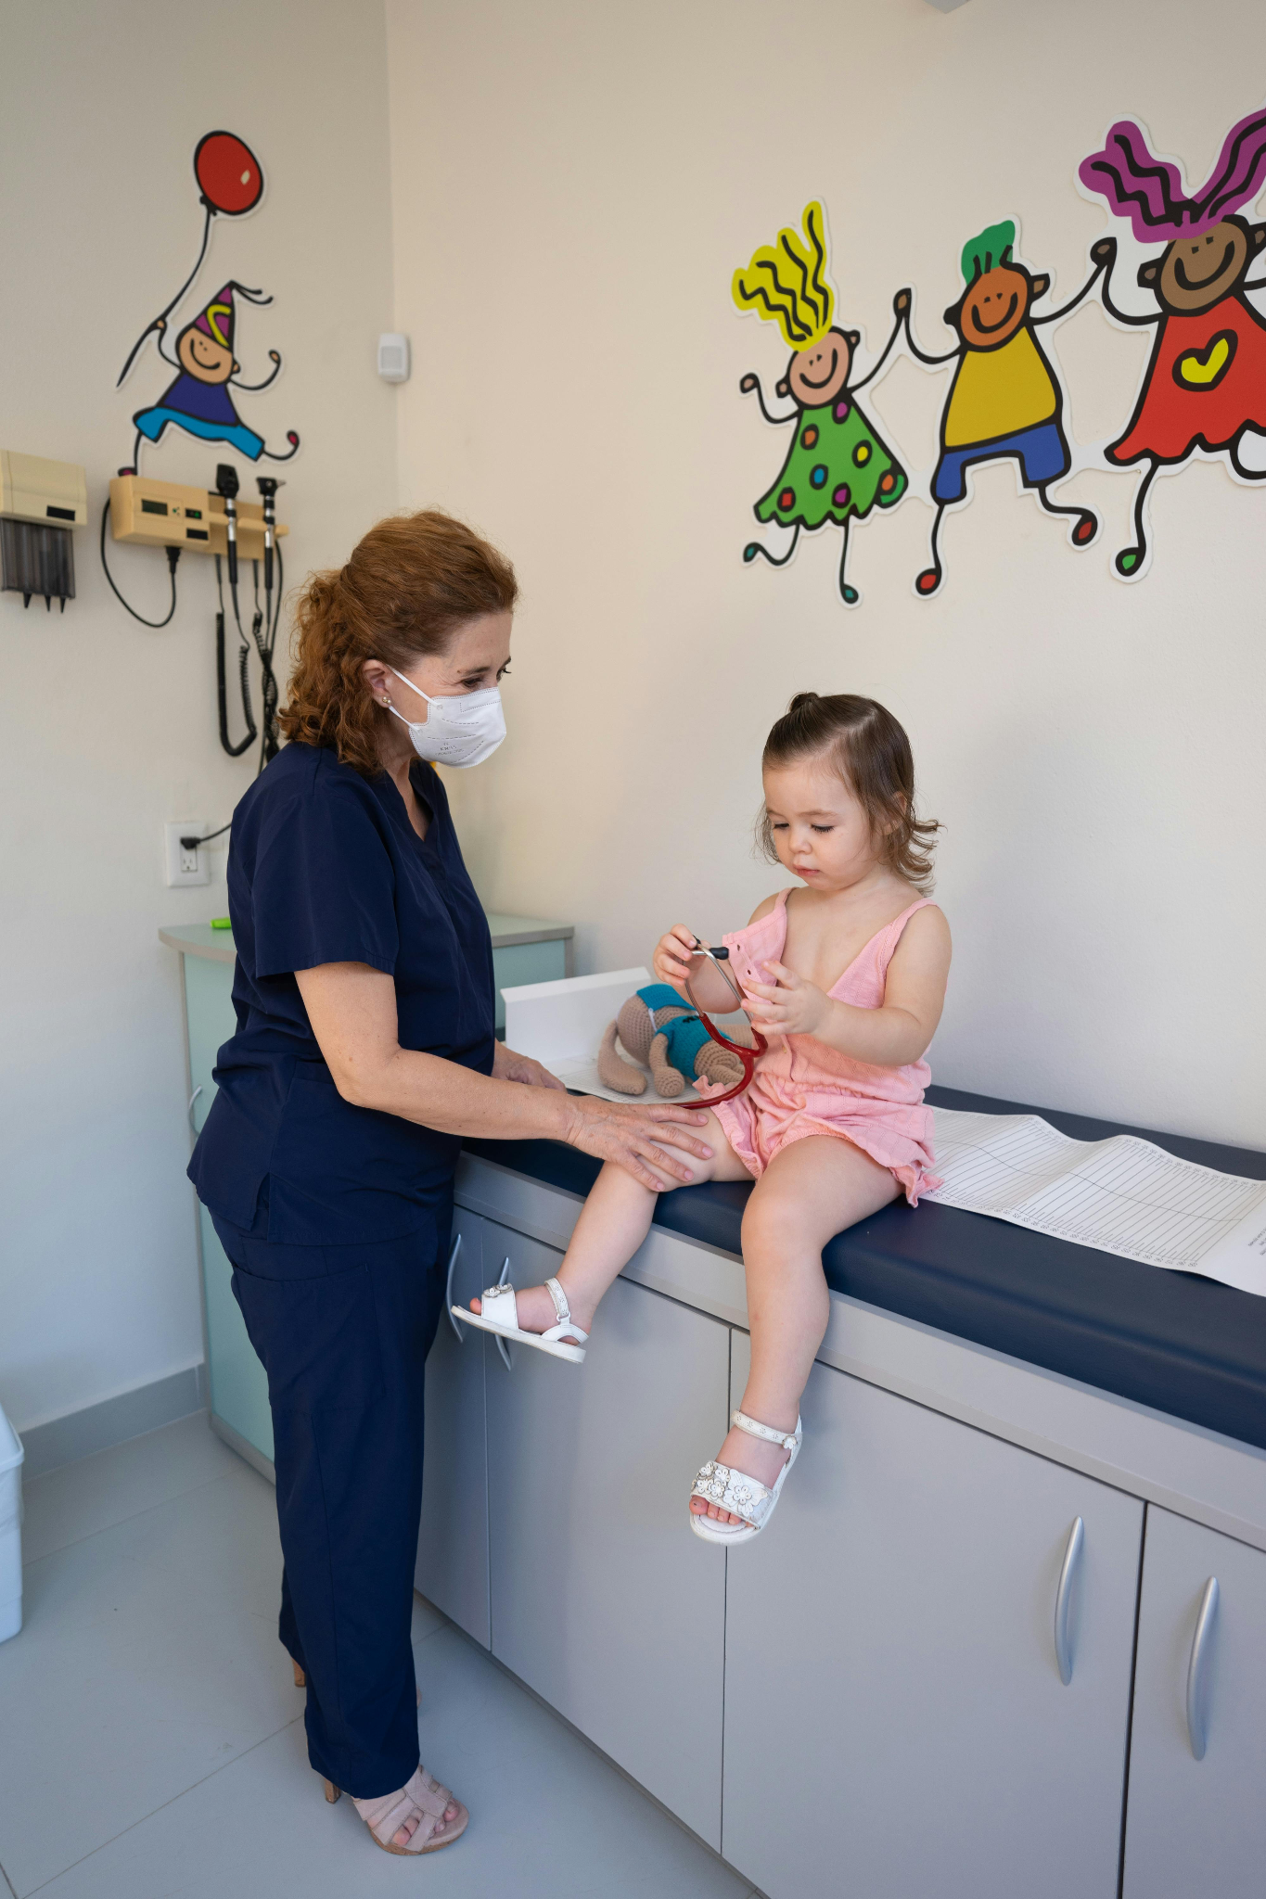
Meet Tracy
Tracy is a soon-to-be grandmother and pediatric nurse from Missouri. As a mother and pediatric nurse, Tracy has had a lifetime full of caring for children and is looking forward to this new role as grandmother.
With a grandchild on the way, Tracy is seeking toys to have at her home for her grandchild so that parents do not feel like they have to bring toys with them for the child.
Tracy does not use online selling sets because she does not have much patience for them. She is looking for an easy way to find toys for her grandchild.
Photo by Los Muertos Crew: https://www.pexels.com/photo/doctor-standing-next-to-a-little-girl-in-a-pediatricians-office-8460035/

Slide 9
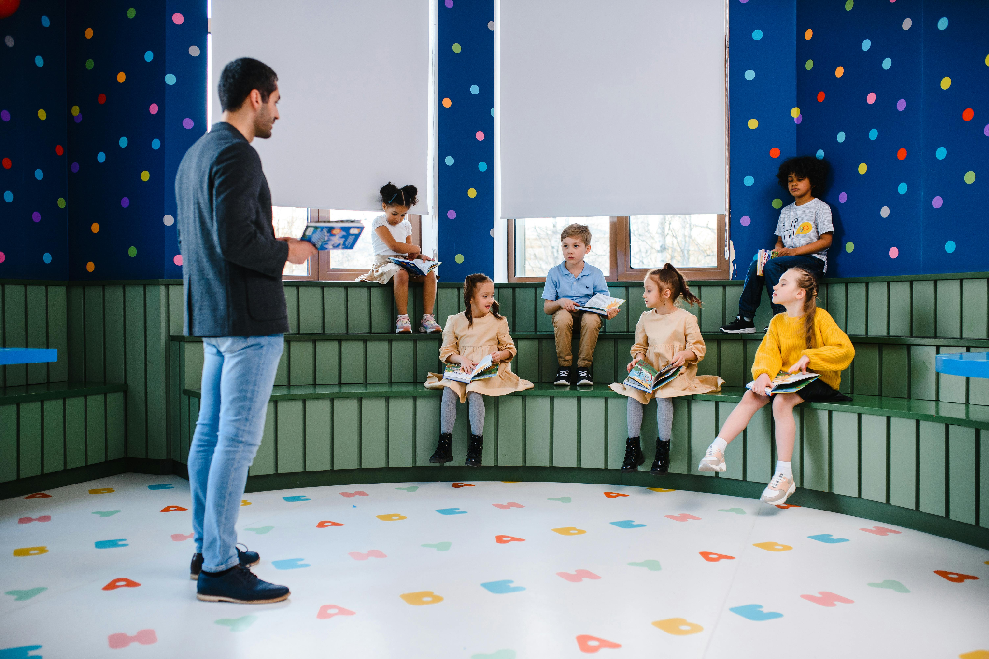
Meet Jack
Jack is a 22 year old, first year kindergarten teacher in Kentucky. As a first year teacher, he is always looking for new items to add to his classroom.
His goal is to find toys for his classroom for playtime and indoor recess. He wants toys that promote education through play.
Jack has tried yard sales and asking for donations from his students’ parents. However, this has not been working and he feels guilty to ask for items from the parents. He is looking for a way to find toys and puzzles for his classroom.
Photo by Anastasia Shuraeva: https://www.pexels.com/photo/children-sitting-in-the-classrrom-8466775/

Slide 10

Desired Features:
Easy Scrolling Function
Location Based Search
Ability to Donate Over Selling
Focus on educational toys
User Verification to Avoid Scams
Toys in Good Condition

Slide 11
Photo Citations
Photo by Anastasia Shuraeva: https://www.pexels.com/photo/children-sitting-in-the-classrrom-8466775/
Photo by Los Muertos Crew: https://www.pexels.com/photo/doctor-standing-next-to-a-little-girl-in-a-pediatricians-office-8460035/
Photo by Ketut Subiyanto: https://www.pexels.com/photo/happy-mother-working-from-home-and-little-daughter-hugging-mom-4474045/
Photo by Yan Krukau: https://www.pexels.com/photo/boy-standing-in-front-of-a-blackboard-beside-a-woman-seated-on-a-bean-bag-8613090/

